Slide 1
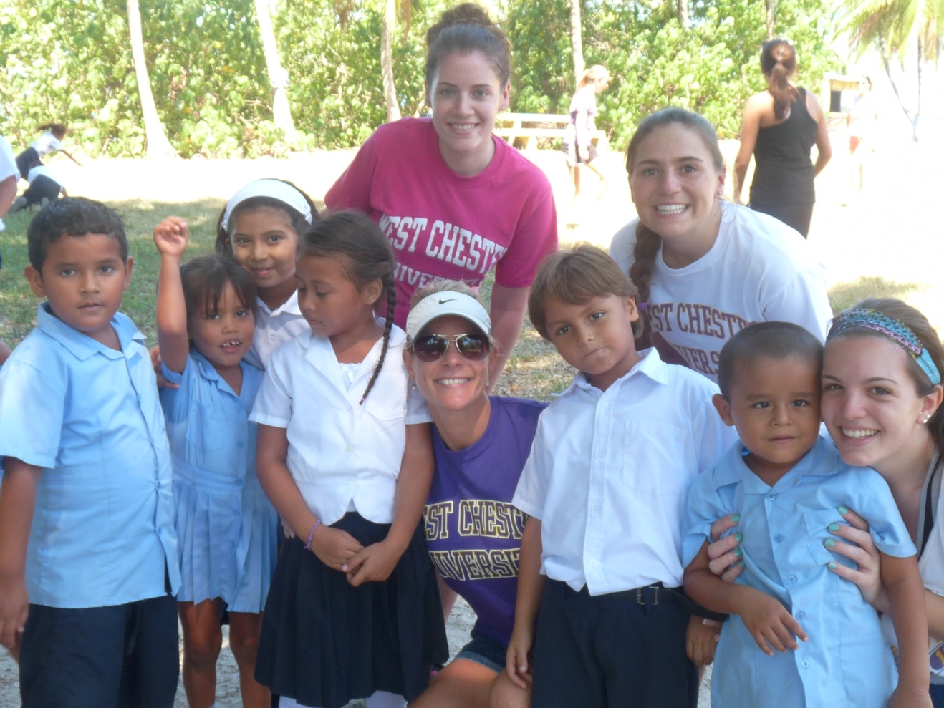
The Intersection of Community Service, Activism & Global Leadership…...but where do Bottlecaps fit in?
Dr. Donna R. Sanderson
West Chester University
2020

Slide 2
Hugh Evans – Global Citizens, TEDTalk
“A global citizen is someone who self identifies first & foremost not as a member of a specific state, tribe or nation, but as a member of the human race. Someone who is prepared to act on that belief to tackle our worlds greatest challenges.”
“You can be a global citizen. Our world’s future depends on global citizens.”

Slide 3

Hugh Evans – Global Citizens, TEDTalk

Slide 4
Hugh Evans – Global Citizens
TEDTalk
Davinia - born in Jamaica, immigrated at 18, now lives outside DC
Penny collection - impact started small
Used social media for help
“Spends time weekly focusing on people who are not her. People not in her neighborhood, state, nor even her country.”

Slide 5
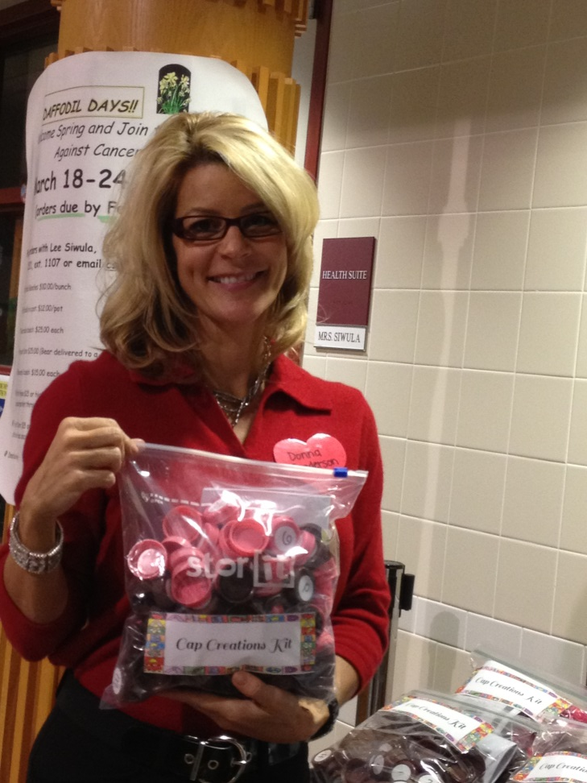
And the story begins….
In the beginning, October 2012
Friends of Liberia consultant – no $, no space, no supplies…hum, I have an idea!
Share with EGP 322 – Pre-K Methods & Field
Hey Dr. Sanderson, I have a question…BOOM!

Slide 6
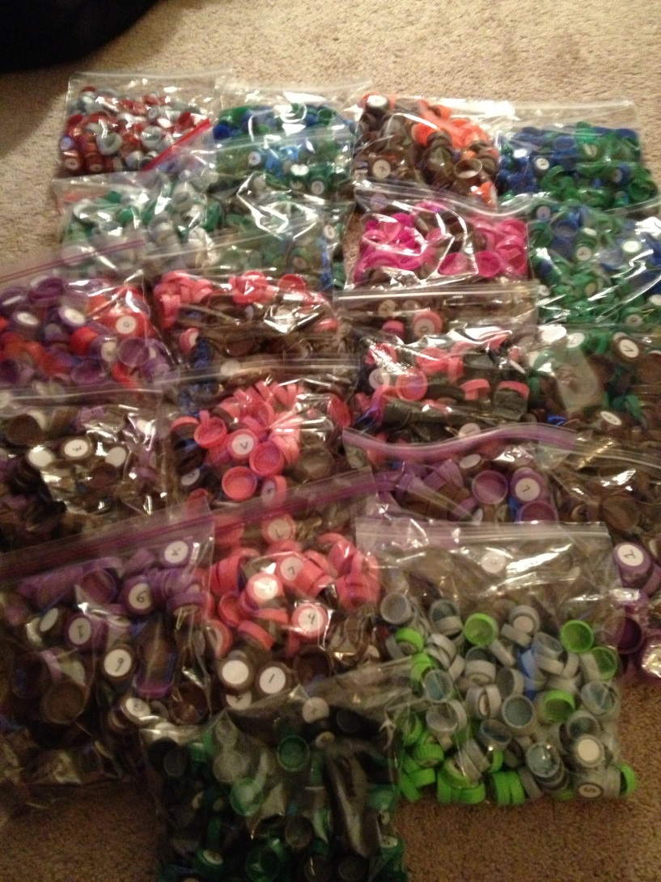
And Cap Kits were born….
Cap Kits are hand-made educational learning manipulatives made from recycled bottle caps.
They assist children in learning emergent literacy and math skills.

Slide 7
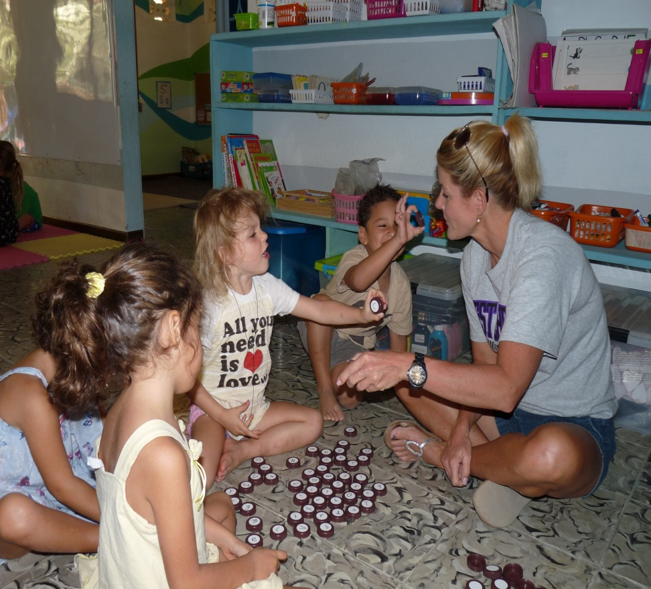
Main Goals of the Cap Kits Project
1 . To create and bring recycled, developmentally appropriate educational materials that support the Common Core Standards to young students.
2. To provide training to teachers and parents on how to effectively create and use the materials with children at school & home.

Slide 8
Major Take Aways
Know that your ideas matter & are important
Start small
Enlist the help of others – know each persons special strengths & talents. What do they bring to the table?
$$ helps move ideas forward
Be willing to take risks

Slide 9
Why Cap Kits Work:
Child Development Theory
Child development theorists assert that learning is “an active, highly evolving, hands-on and complex process.”
Young children need to learn with “their head, heart and hands.” This is called active, experiential learning, it is hands-on in nature and it is how young children acquire knowledge.
Children learn the most when they are actively participating in the learning process (Katz, 1994)
Children learn best when they are encouraged to explore, interact, create and play (Thompkins, 1991)

Slide 10
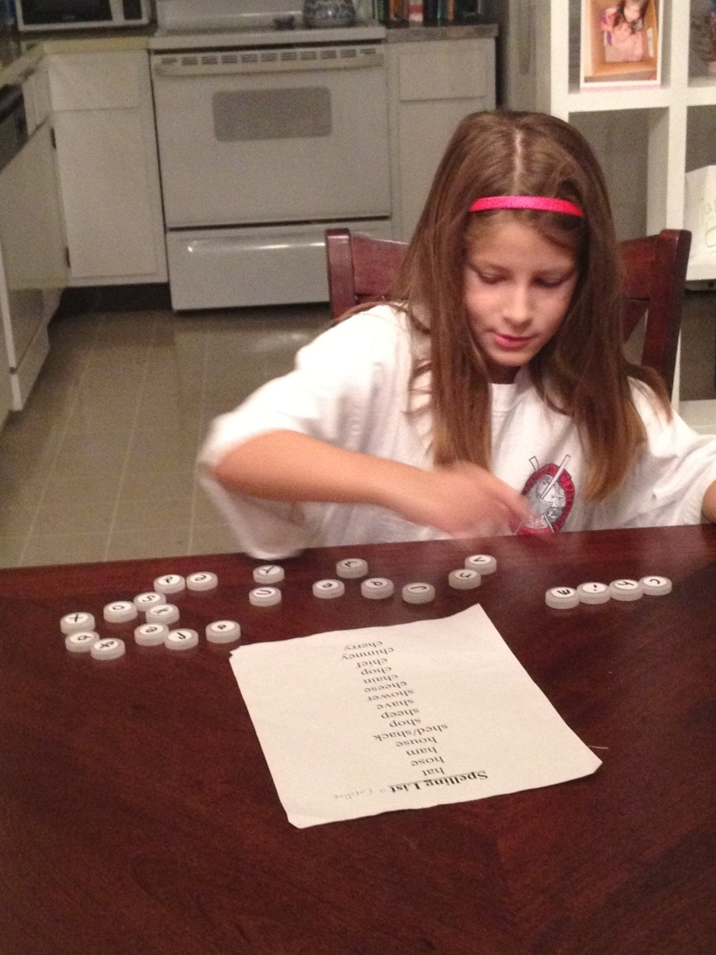
Why Cap Kits Work:
Child Development Theory
“During play, young children use hands-on exploration and sensory learning in a very important way; they confidently test new knowledge in a relaxed atmosphere, relate it intuitively to existing knowledge, and store that information for future use.” (Blaustein, 2005)

Slide 11
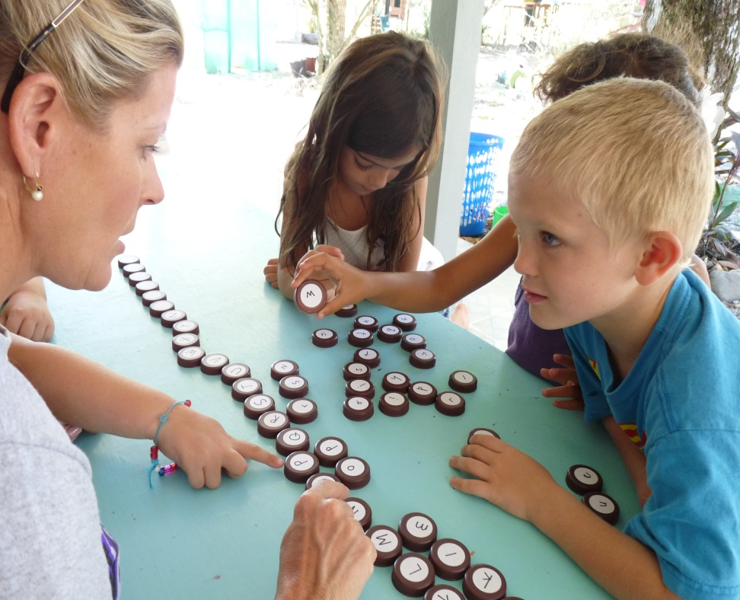
Positives of the Cap Kits
Recyclable and promote “green awareness”
Developmentally appropriate for a variety of age groups/grades
Can be used at home and/or at school with multiple languages
Support Common Core Learning Standards
Highly creative (award winner)

Slide 12
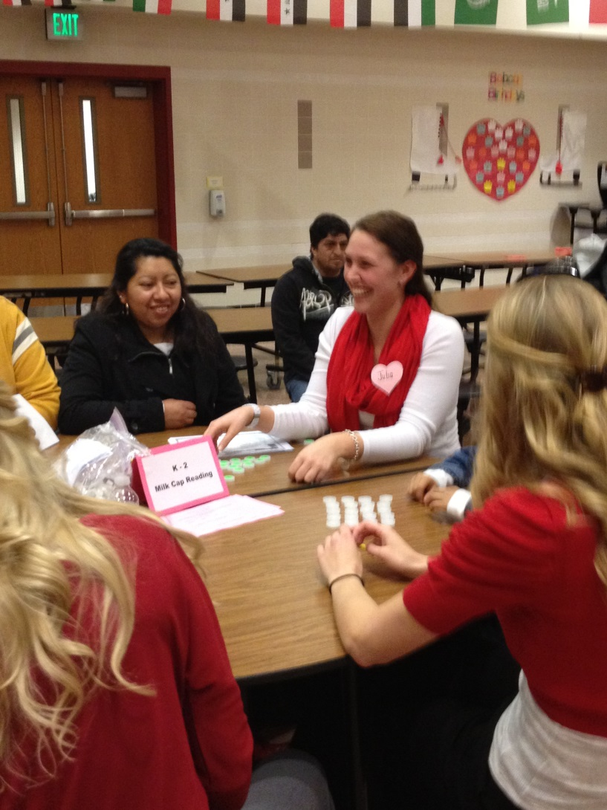
Positives of the Cap Kits
Both teachers and parents can learn how to create and use them
A sustainable initiative that is easily reproducible
Inexpensive to create
Fun and engaging for students
Can be used in a variety of ways & only limited by your own creativity

Slide 13
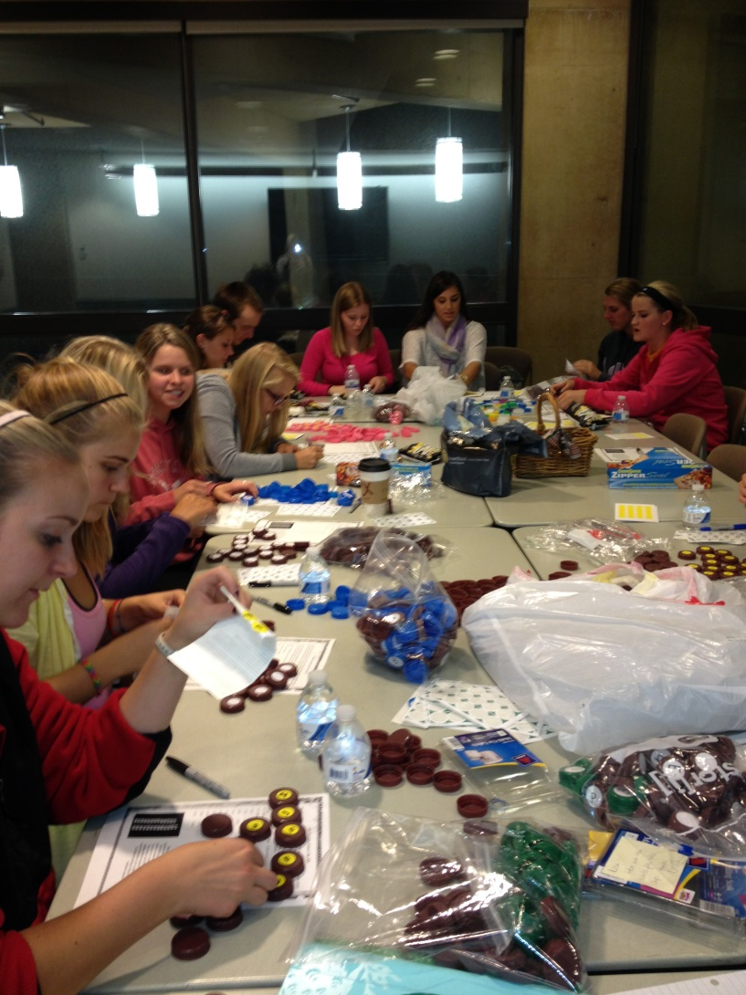
The Makings of a Cap Kit
Ingredients needed:
126 plastic bottle caps (water, soda, milk, ice tea, Gatorade, etc.)
Sharpie markers
Avery round labels (1 inch for milk caps, ¾ inch for water bottle caps)
Gallon plastic bag for storage

Slide 14
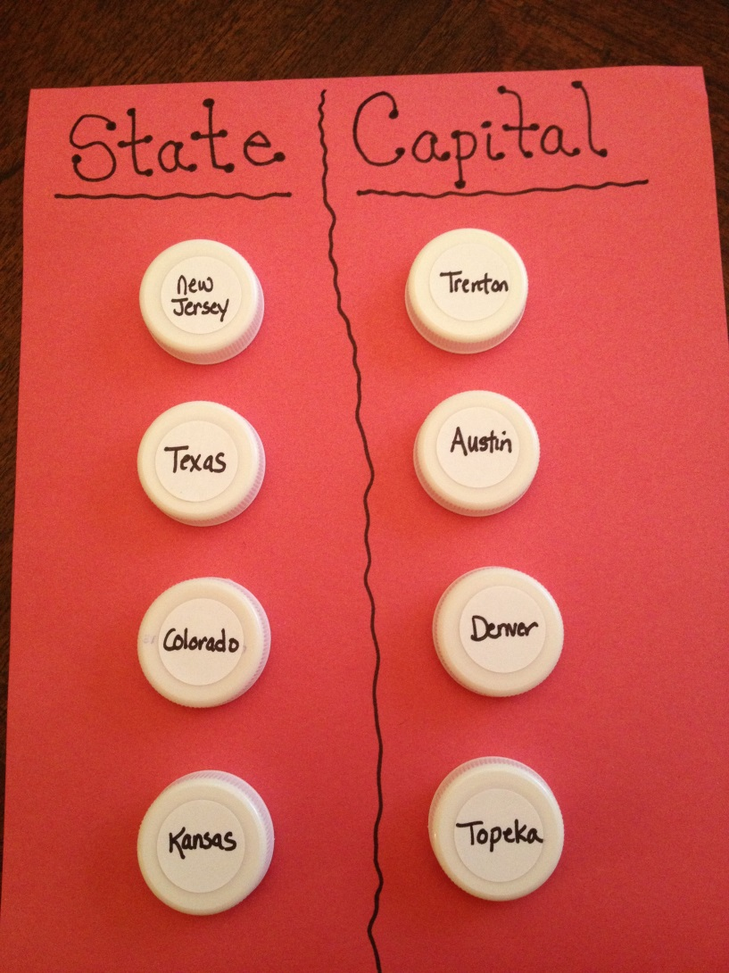
Emergent Literacy Games with Cap Kits
Alphabetical order to ABC song
Match upper & lower case letters
Letter recognition out of the bag
Letter Monster
Go Fish! Memory game
Alphabet Silly Soup or Name Soup

Slide 15
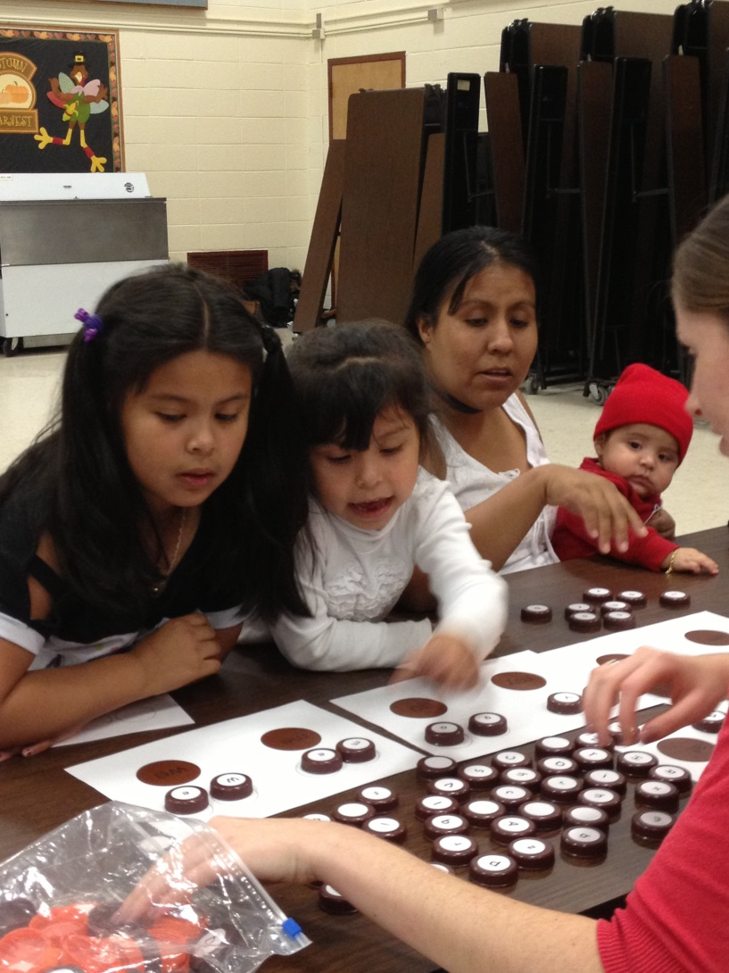
Emergent Literacy Games with Cap Kits
Letter switch with CVC word families (big, pig, dig)
Silent –e words (CVCE)
Dig for caps in rice, sand or play-dough for sensory learning
Alphabet train
Letter BINGO

Slide 16
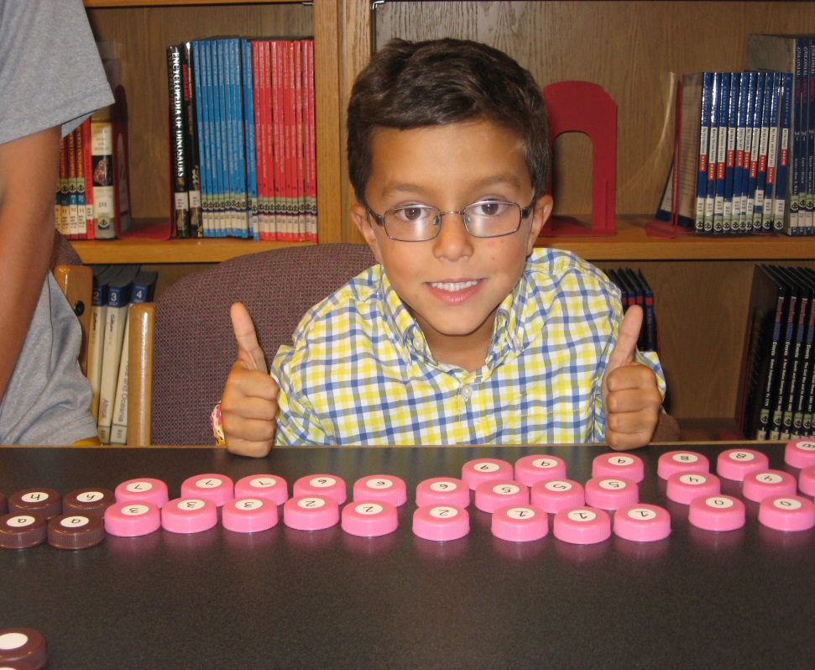
Emergent Math Games with Cap Kits
Make a number line
Number recognition (out of order)
1-1 correspondence by demonstration
Color sorting
Patterning with colors or shapes
Egg carton math

Slide 17
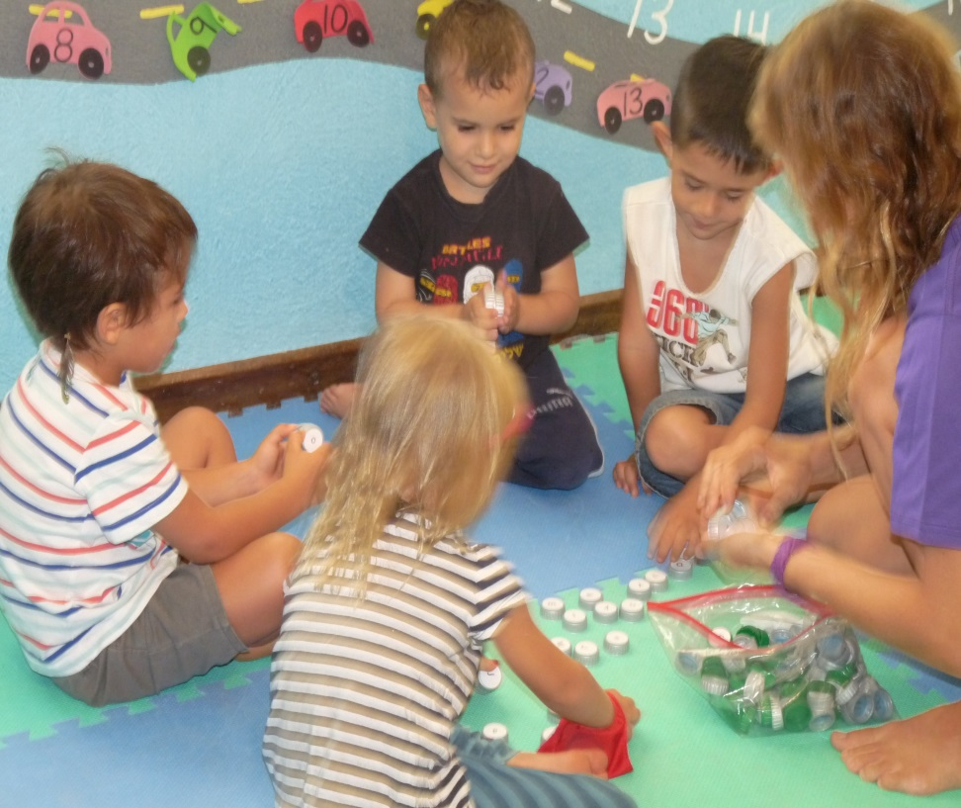
Emergent Math Games with Cap Kits
Number stamps
Dice cap game for addition or subtraction
Numeral matching game
Math facts race
Creating number sentences for addition or subtraction

Slide 18
Major Take Aways
Assess community needs
Think about ideas that:
  fill a real need in the community
  are doable (size, money, effort, time)
  are sustainable
  they will have a better chance of succeeding

Slide 19
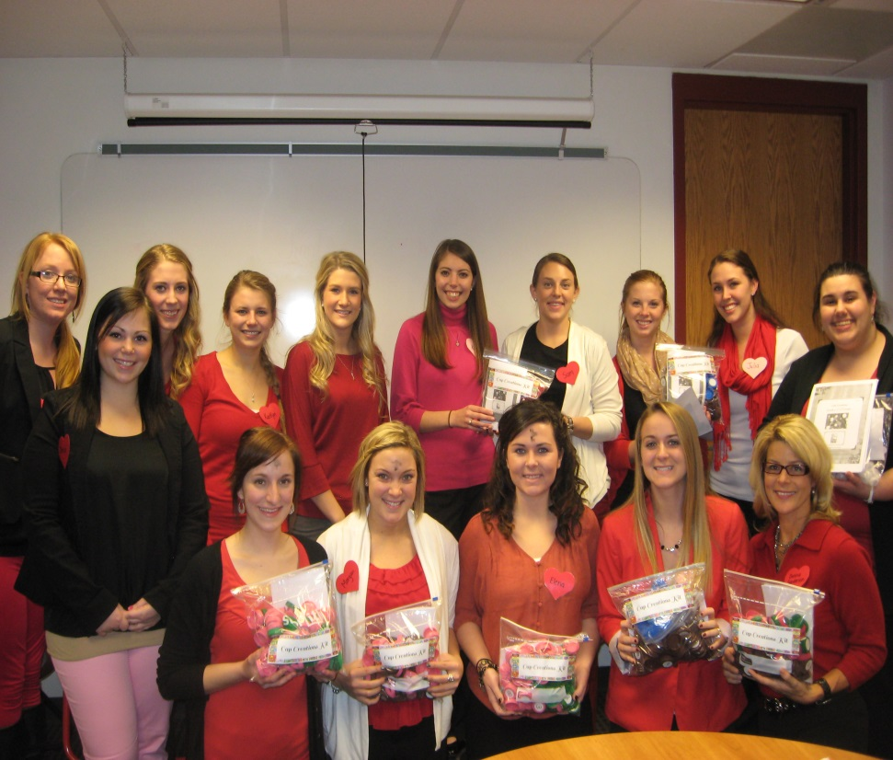
The “Cap Kit Crew”

Slide 20
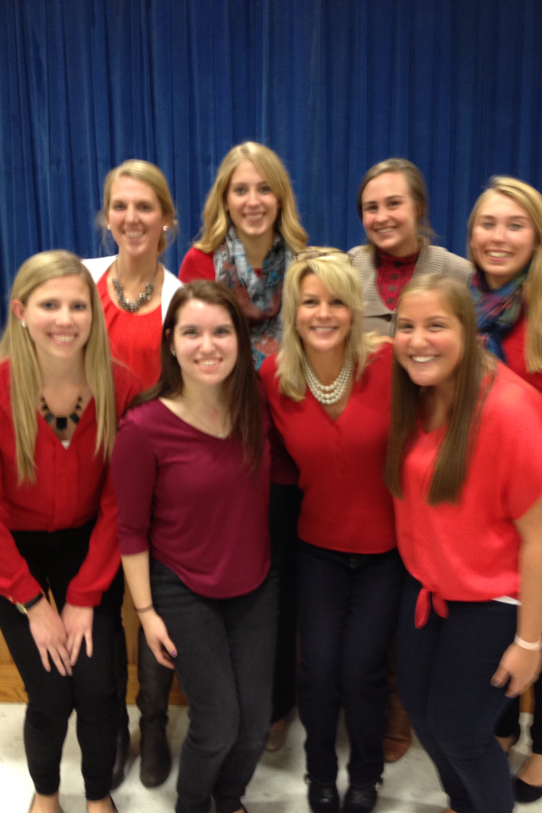
The “Cap Kit Crew”
We are in our ninth semester with an average of 12-18 Early Grades students
Create kits, teacher trainings and parent workshops @ night
Present to other students to propel program forward
Why…because it’s worthwhile and a great learning tool

Slide 21
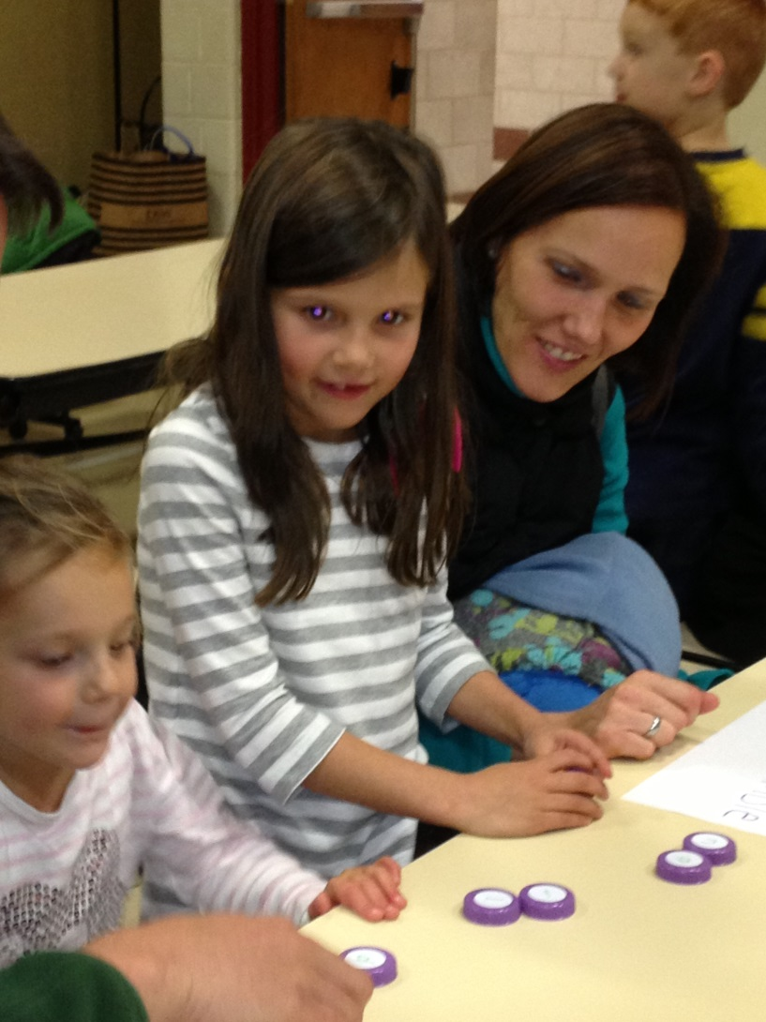
Reaching out to Parents and Families
60 Teacher Trainings in elementary schools & child care centers in three states
30 Parent Workshops at night
Literacy Fairs, SMART Night, Earth Day, ESL Night, etc….
29 conference presentations (international, national, regional, local)
7 grants ($23,000)
1 major University Award

Slide 22
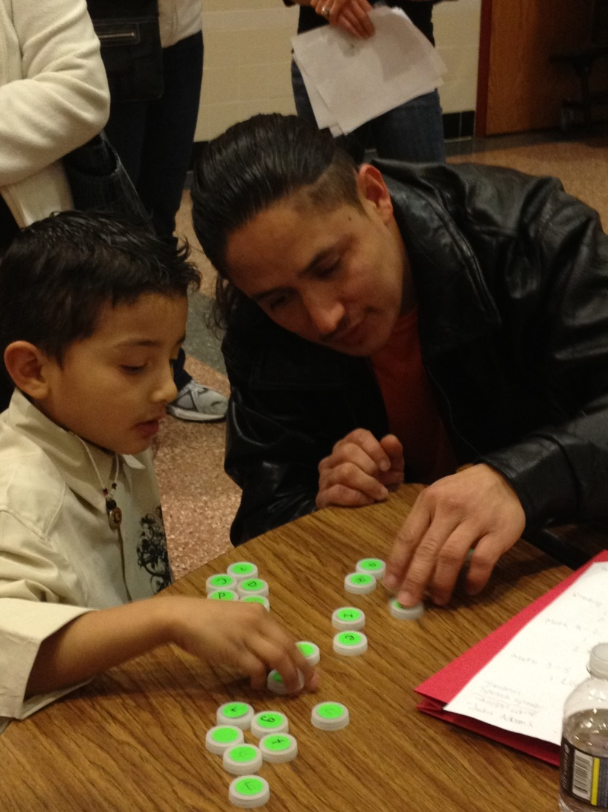
Special ELL and Title I Family Nights
Special Workshops for ESL Families
Connect with ESL specialist
Provide free materials and direction have been translated into Spanish
Some WCU students are bilingual
Small ratio has been very successful

Slide 23
Cap Kits ~ A Whole Website of Ideas
Our website is:
http://thecapcreations.wix.com/capcreations
What you will find:
Hands-on, fun, educational games for students pre-K through 5th grade in literacy and math
Directions on how to create your own cap kits at home
Pictures & directions to create many different games for Pre-K-2 and 3-5 grades

Slide 24
Major Take Aways
Talk with like-minded people – this project is a perfect example of faculty-student collaboration
Let the project lead. I felt this shift from me leading it, to it leading me where it was most needed. Let it naturally unfold.
Be passionate – it shows in what you say and do. Do it for the right reasons.

Slide 25
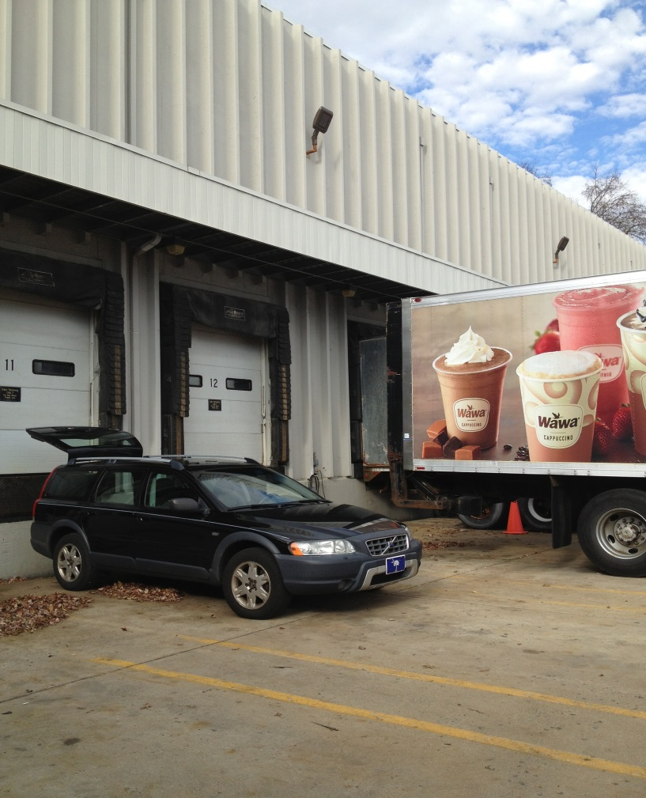
Community Partnerships
Reaching out - Who helps us make Cap Kits?
Church groups, sororities, National Service Honor Society, Girl Scouts, WC Library, Kappa Delta Pi Honor Society, many WCU organizations
Wawa Corporation has generously donated bottle caps for our project for three years - guess how many total?

Slide 26
Wawa & WCU Cap Kit Program
130,000 bottle caps donated
“I’m so happy to hear our Wawa associates helped make a difference. While supporting our communities has always been in Wawa’s DNA, our associates continue to amaze me with their desire to find new and exciting ways to give back. Thanks for all you do to support our community.” - Chris Gheysens, CEO

Slide 27
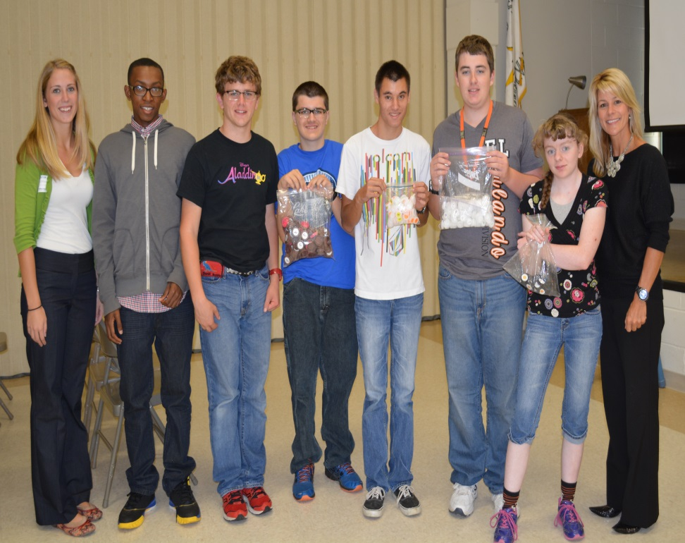
Community Partnership with Vanguard
The Vanguard School
  WCU brings them supplies & they create cap kits then they are given back to us so we can distribute to youngsters’ schools and homes
  2014-15: created 137 kits
  2015-16: created 150 kit
  2016-17: goal is 150
  40 students, 15-18 years old create the kits and work on:
    Social skills, working together, organizational skills, counting skills, language skills

Slide 28
Major Take Aways
Reach out into the community in multiple ways and get exposure (social media, visit businesses, newspapers, talk it up)
Don’t be afraid to ask for help and support
Thank others when they support you – use your manners!
Look at what others can learn by helping support the idea/project – reciprocal help

Slide 29
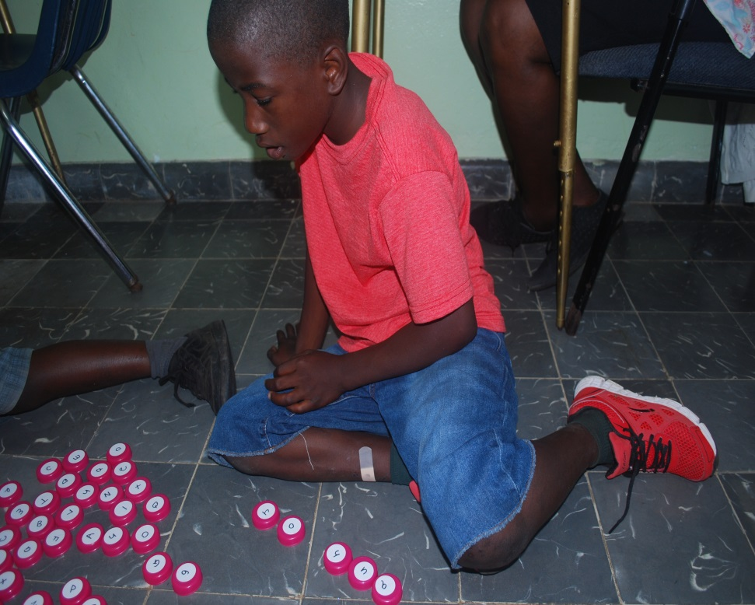
Growing International Tentacles
We now have brought Cap Kits to these countries:
Costa Rica
Guatemala
El Salvador
Honduras
Peru
The Bahamas
Malawi, Africa
Guatemala

Slide 30
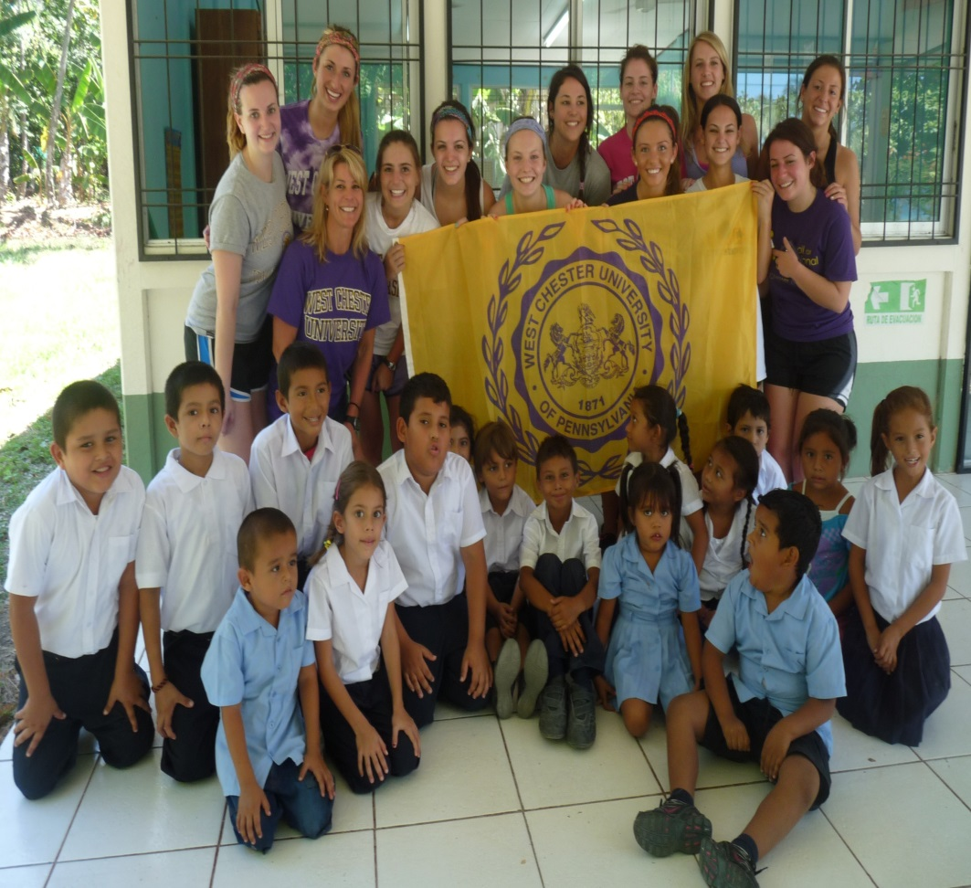
“Educating Youth Across Borders”
Brought 12 pre-service teacher candidates to the Nicoya Peninsula in Costa Rica over Spring Break 2015
Taught lessons, brought needed supplies and reflected nightly
We brought 50 Cap Kits & conduct teacher & parent
trainings at:
  Escuela Mal Pais
  Little People Non-Profit
  Escuela Futuro Verde

Slide 31
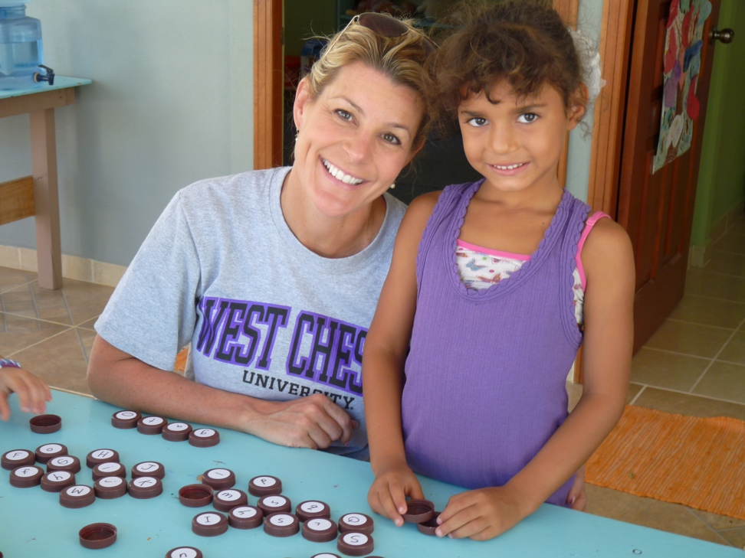
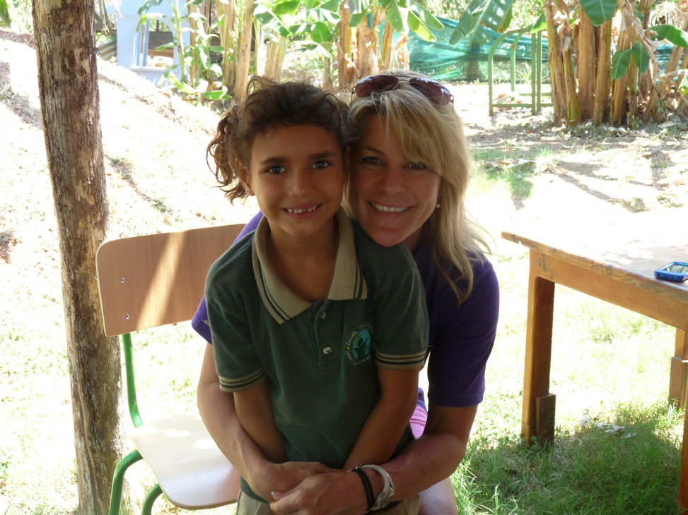
“Educating Youth Across Borders”
2014
2015

Slide 32
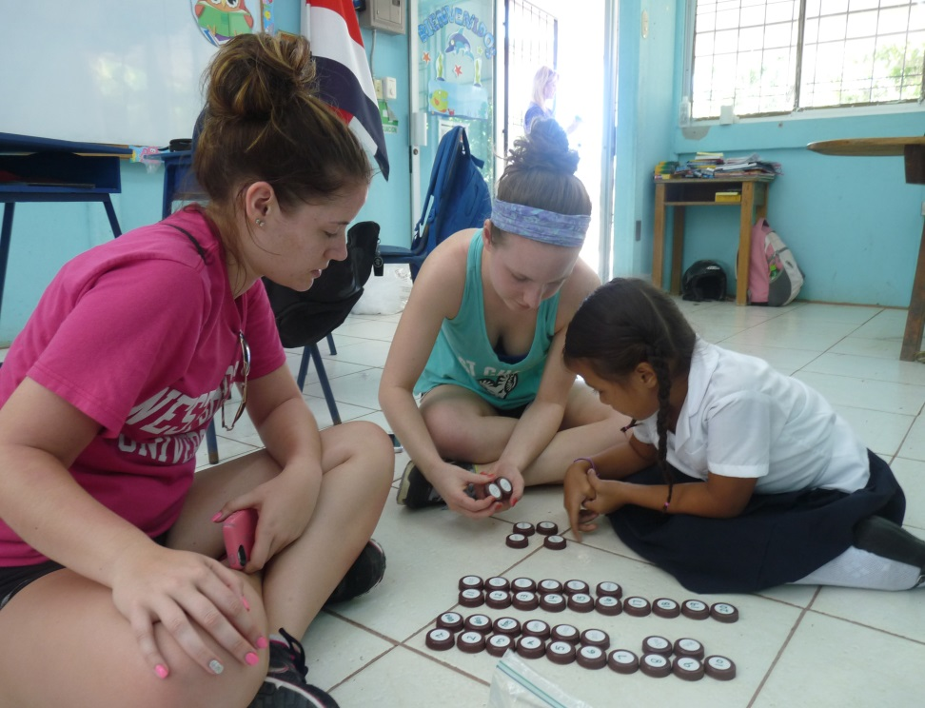
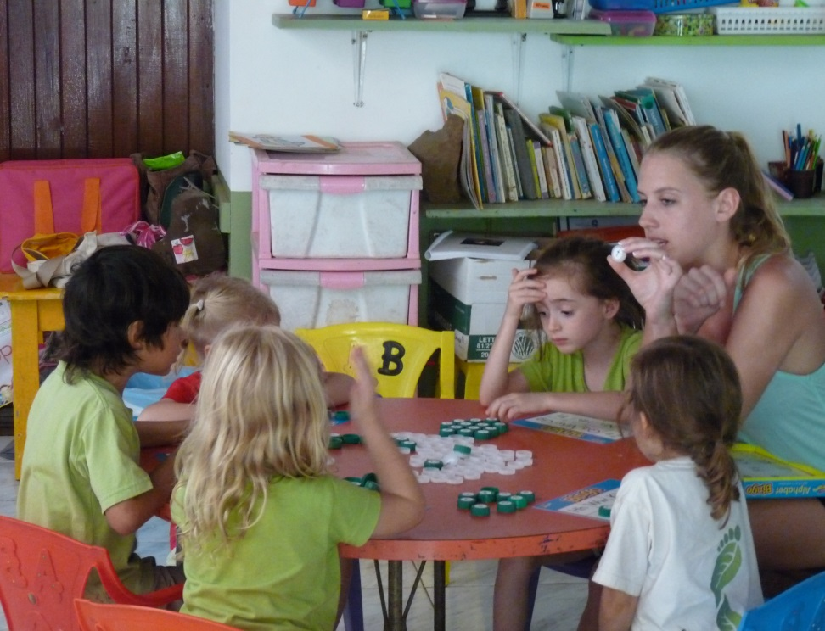
“Educating Youth Across Borders”

Slide 33
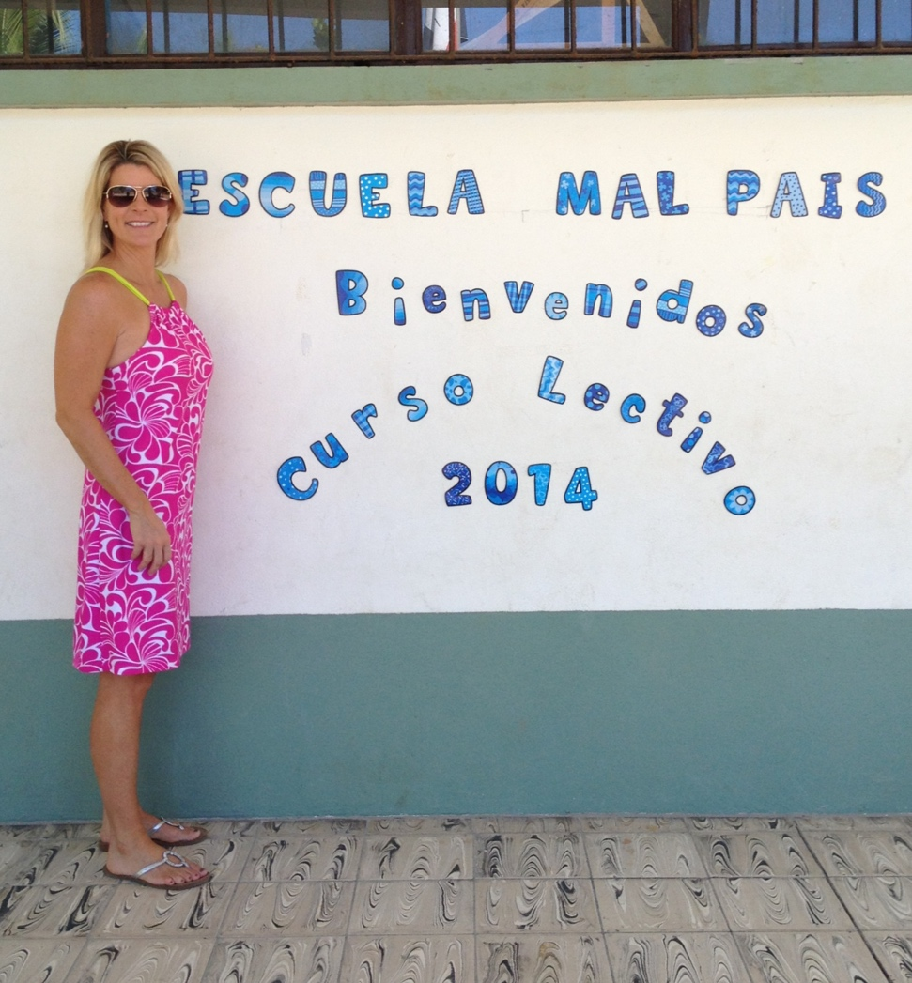
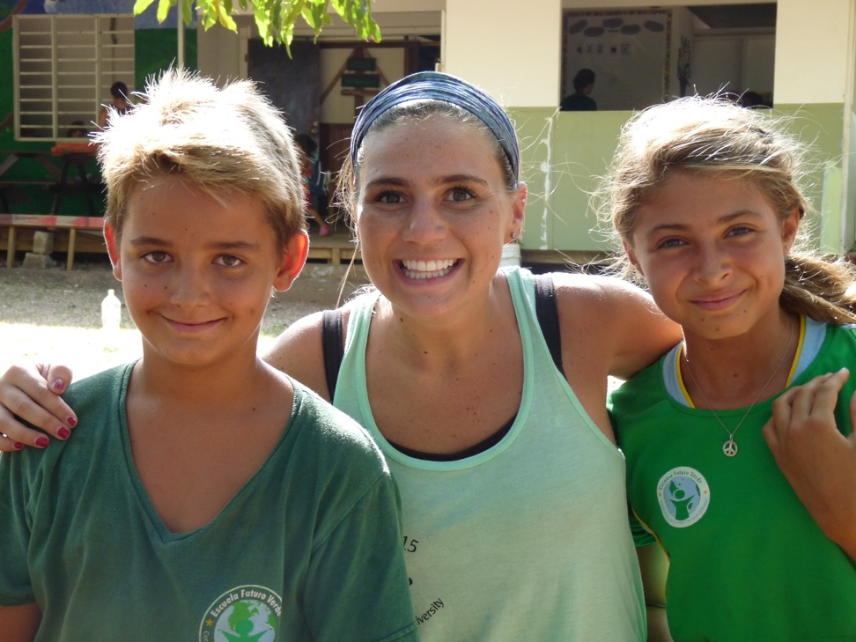
“Educating Youth Across Borders”

Slide 34
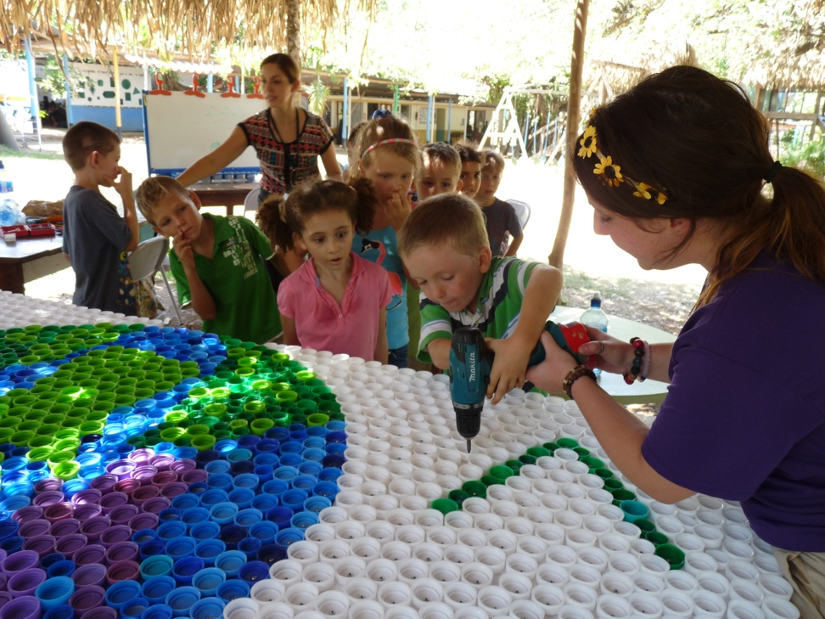
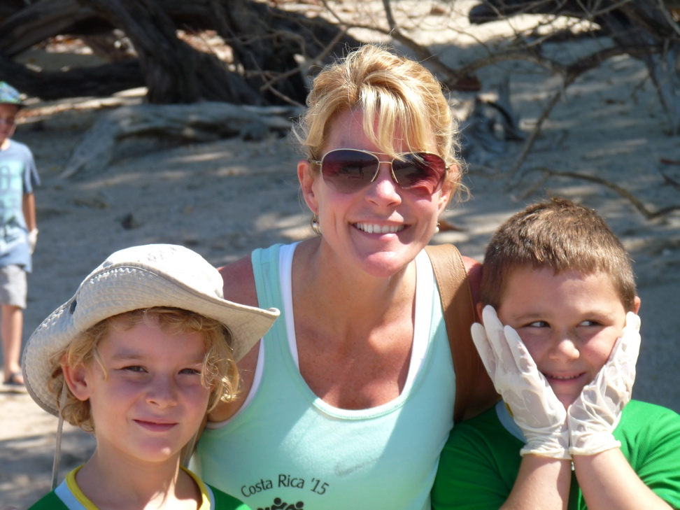
“Educating Youth Across Borders”

Slide 35
Voices 4 Peru
Los Lomas, Ventanilla
International school received Cap Kits. Private preschool 40 + children all 3, 4, 5 years old
Exploratory trip spring break 2017
Through talking and communicating with like-minded others this opportunity arose.
Bringing needed supplies like books & sneakers along with Cap Kits

Slide 36
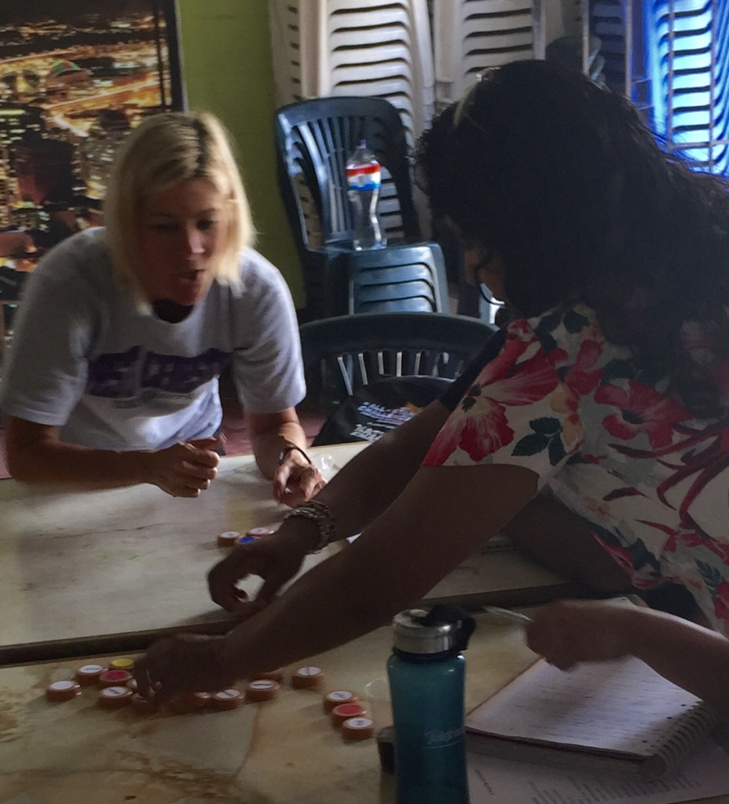
Voices 4 Peru
Los Lomas, Ventanilla
Collaborate with non-profits. V4P
Collaborate between different colleges & departments at WCU (Criminal Justice Dept.)
Community service trip to build a house & work in preschool

Slide 37
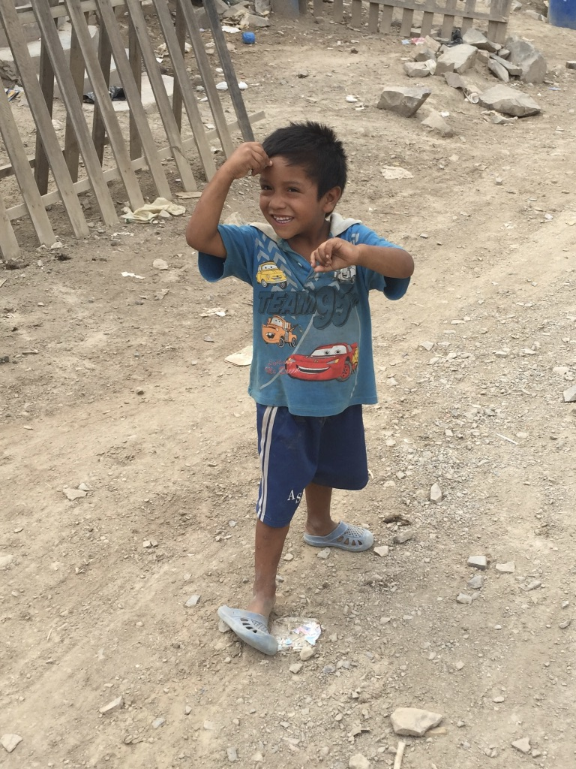
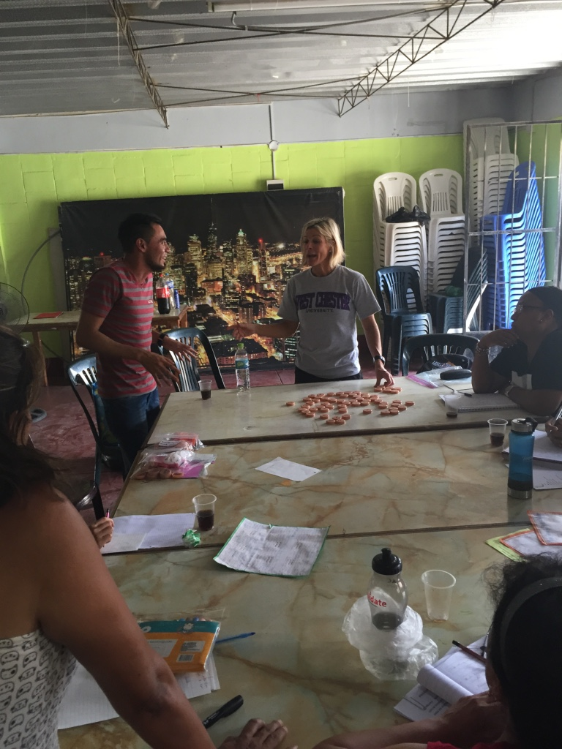
Voices 4 Peru
Los Lomas, Ventanilla

Slide 38
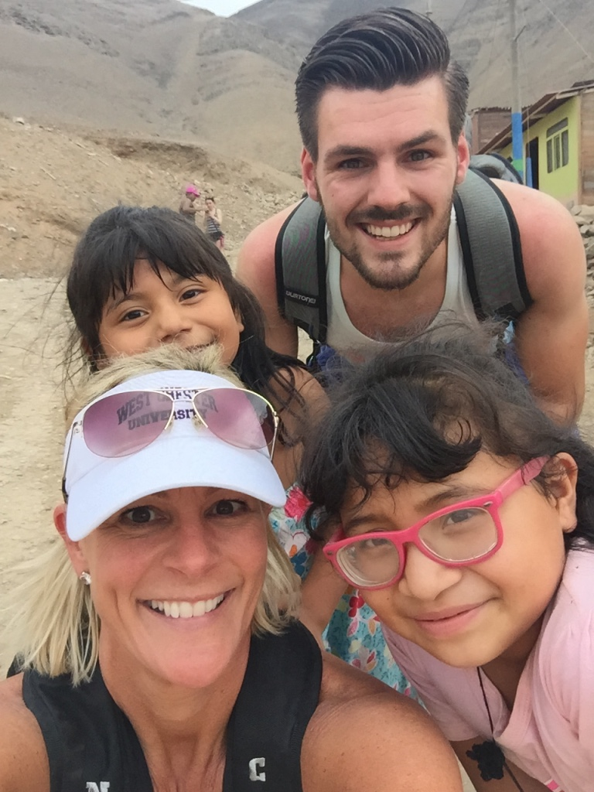
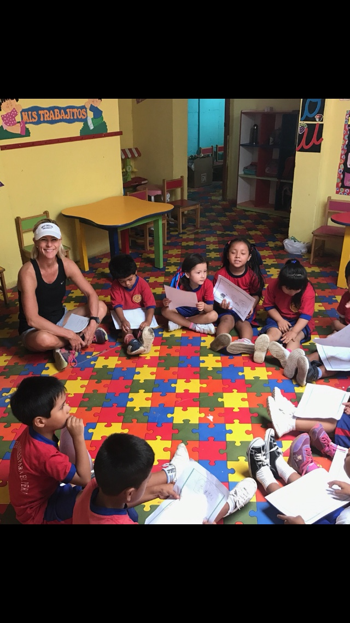
Voices 4 Peru
Los Lomas, Ventanilla

Slide 39
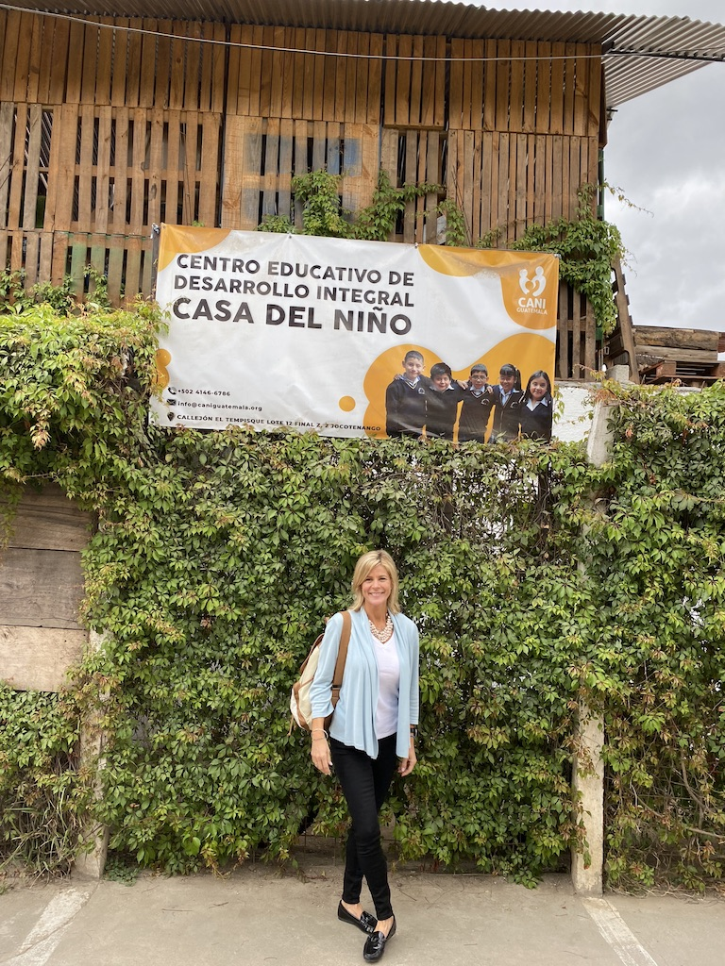
Los Amigos de Casa del Nino
Jocotenango, Guatemala
March, 2020
In-serviced teachers Pre-K – 5th grade
Brought basic Cap Kits and specialty Cap Kits in Spanish
Teachers created Cap Kit games to align with their curriculum

Slide 40
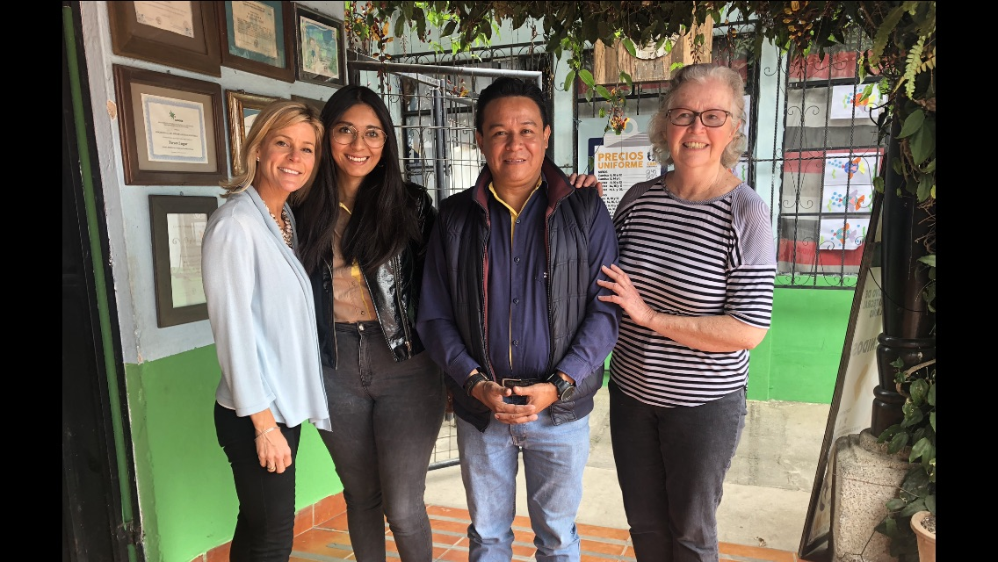
Los Amigos de Casa del Nino
Jocotenango, Guatemala

Slide 41
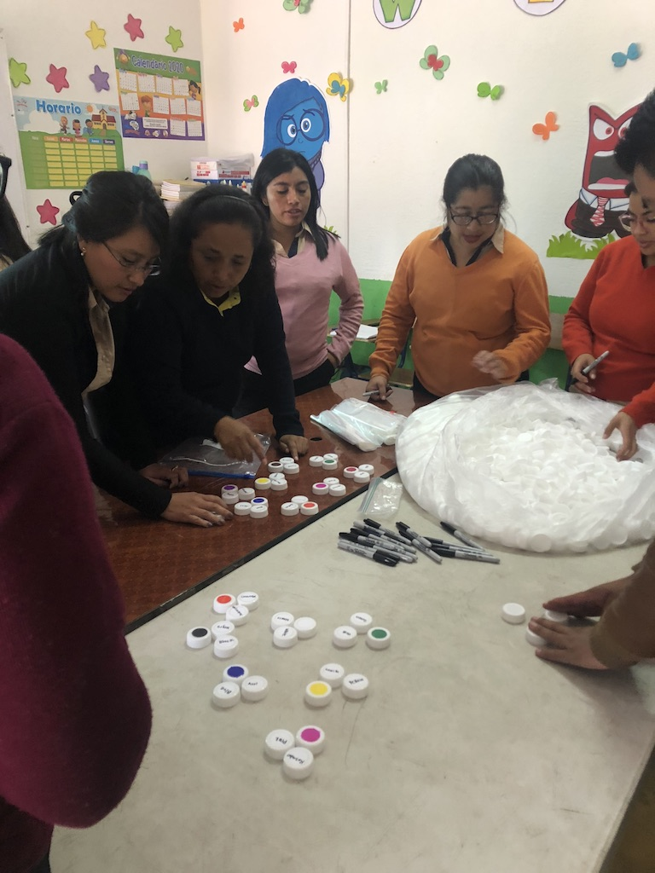
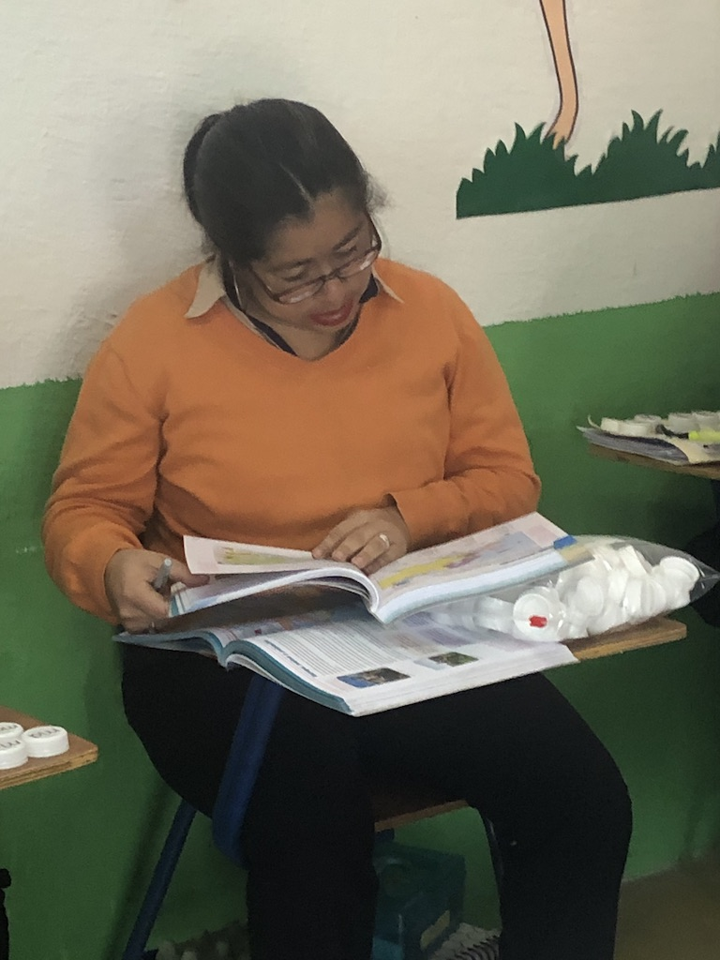
Los Amigos de Casa del Nino
Jocotenango, Guatemala

Slide 42
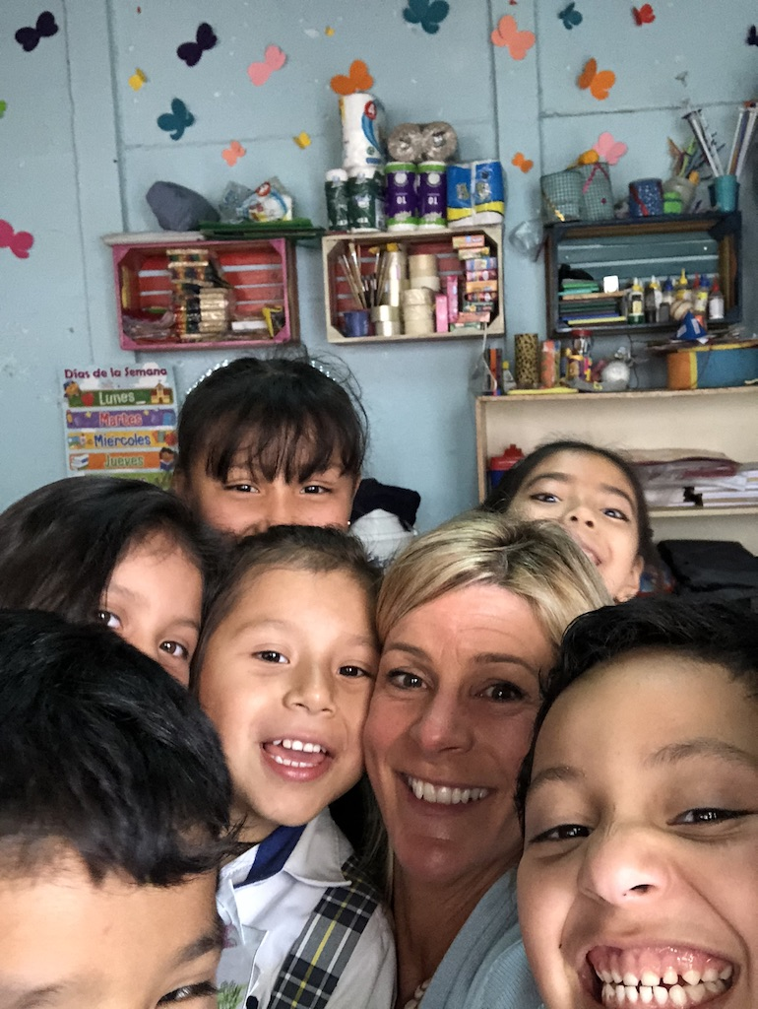
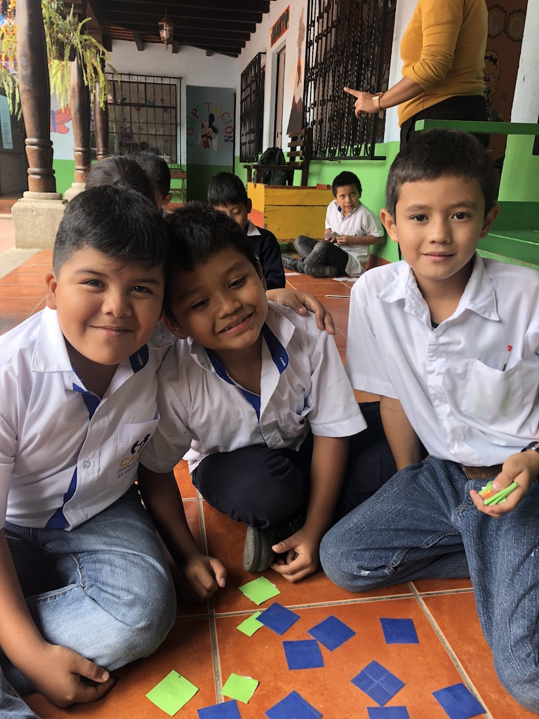
Los Amigos de Casa del Nino
Jocotenango, Guatemala

Slide 43
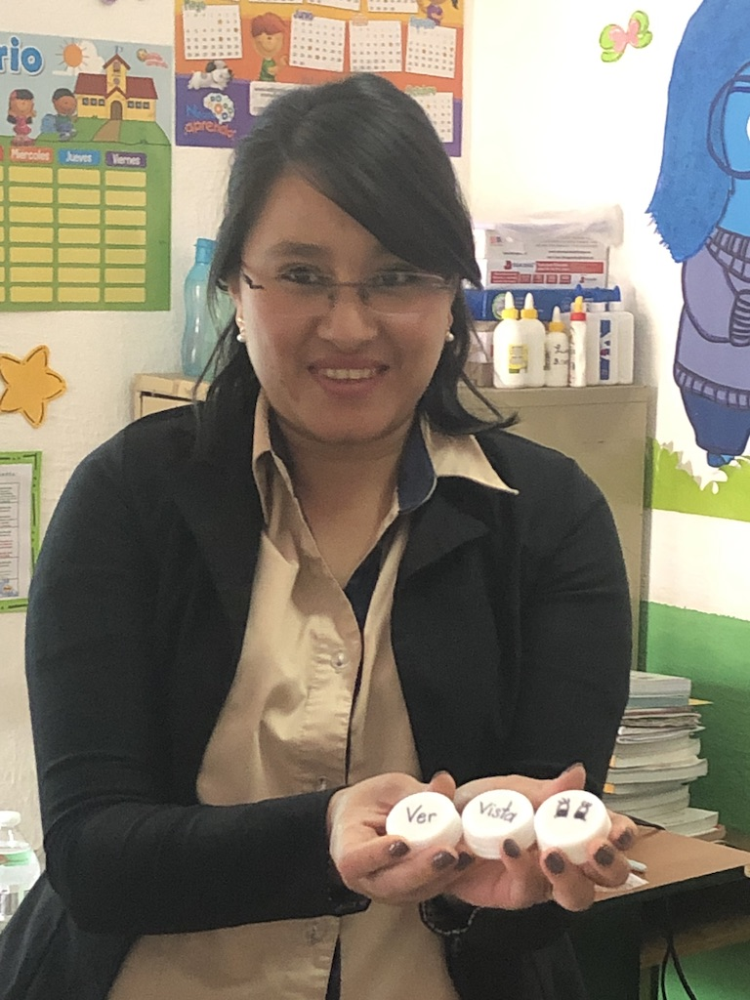
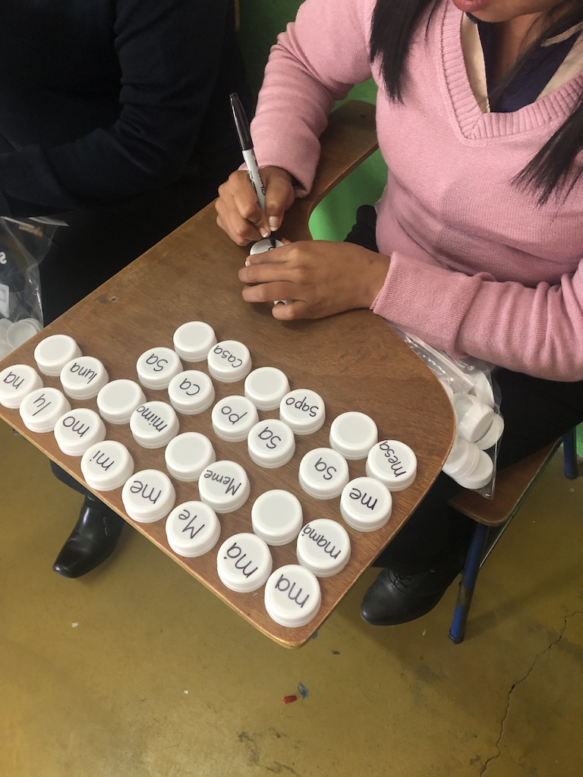
Los Amigos de Casa del Nino
Jocotenango, Guatemala

Slide 44
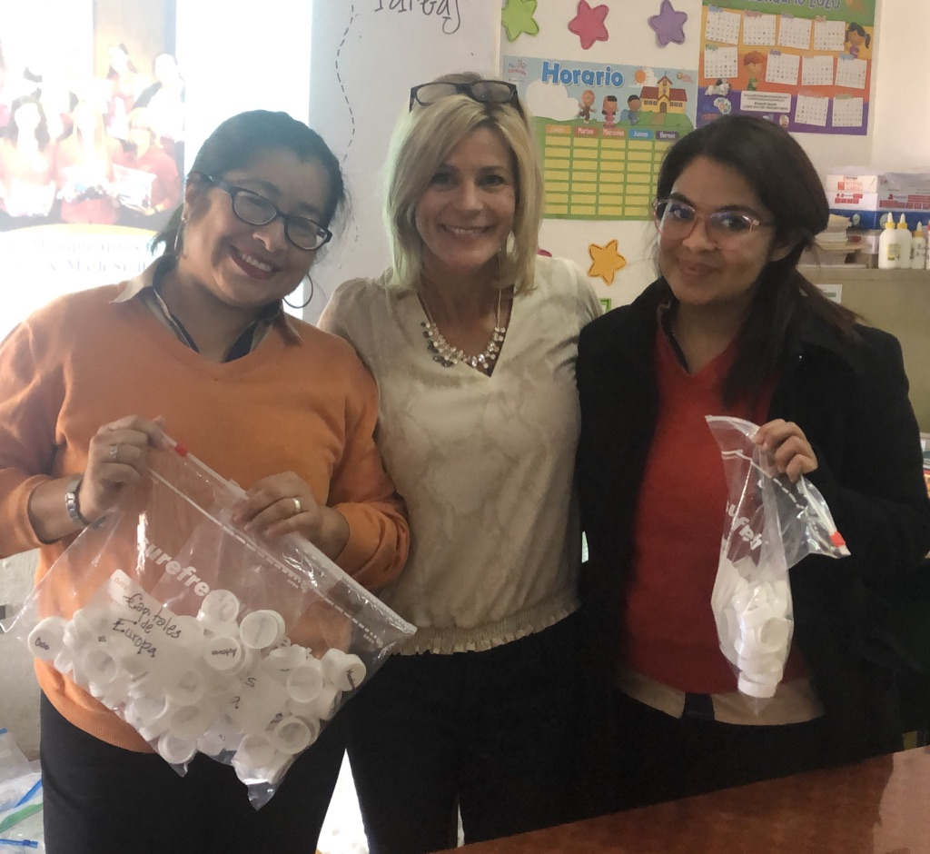
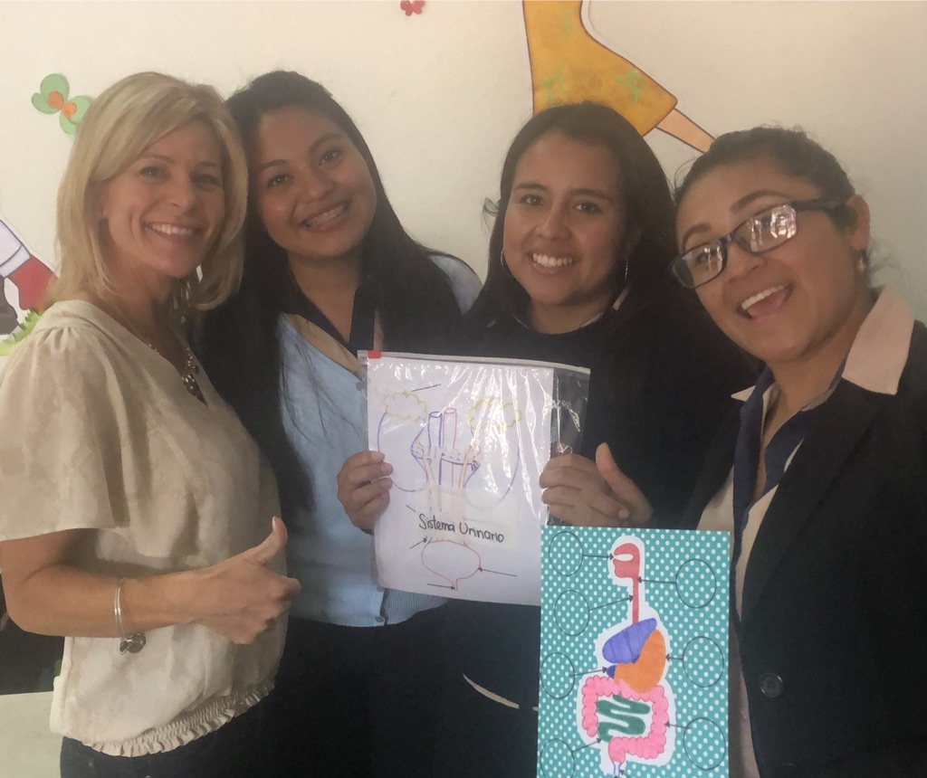
Los Amigos de Casa del Nino
Jocotenango, Guatemala

Slide 45
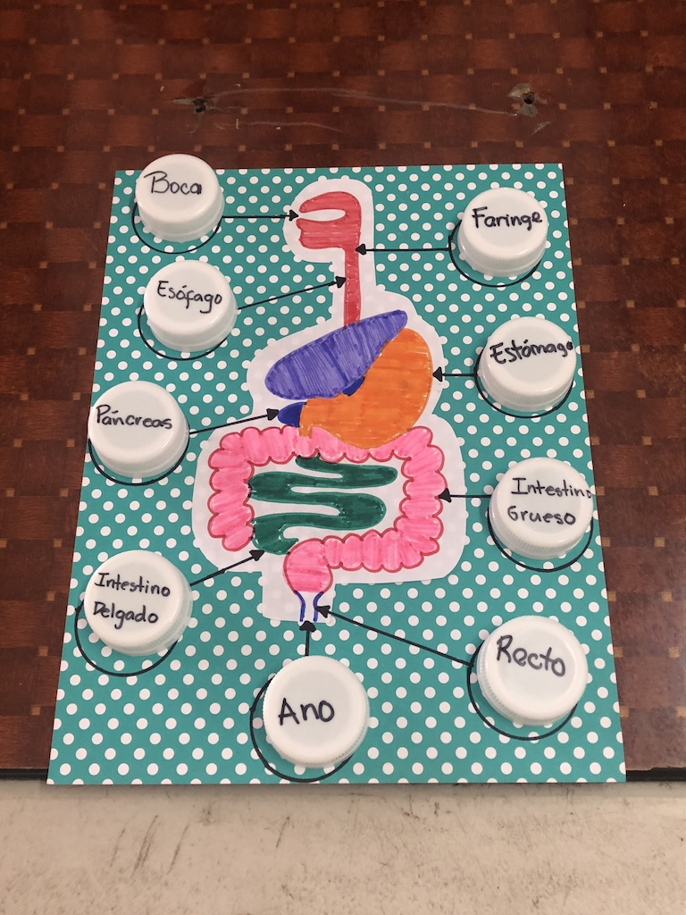
Los Amigos de Casa del Nino
Jocotenango, Guatemala
Teachers created their own hands-on, specialized Cap Kit materials based on specific curriculum content.
The versatility of the Cap Kits makes them appropriate to use in all grades.

Slide 46
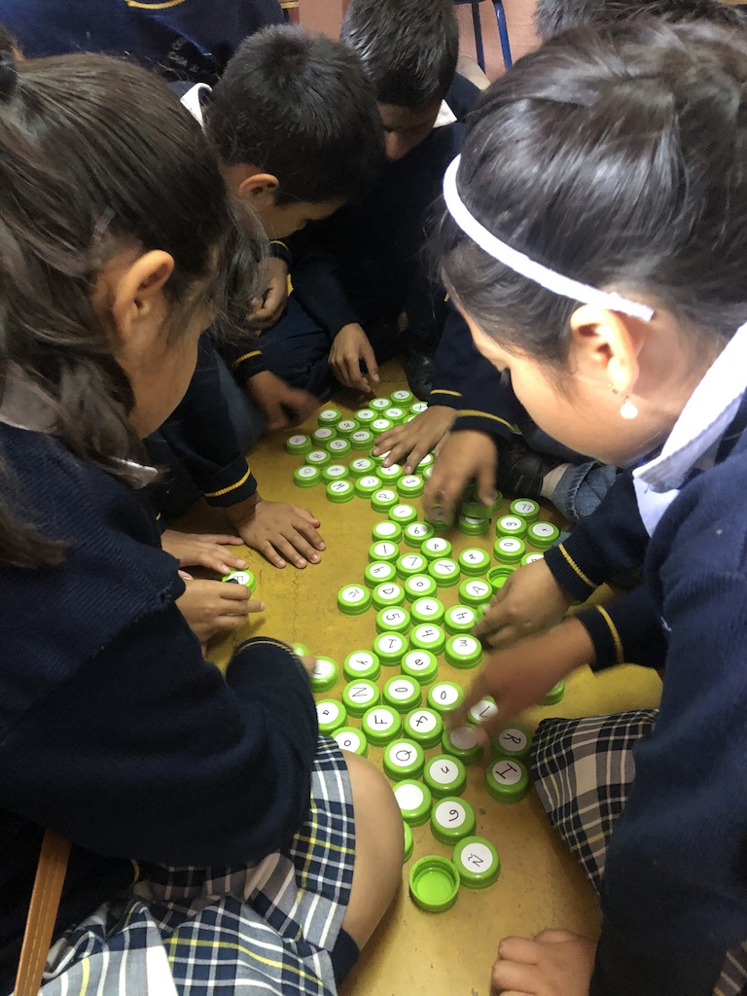
Los Amigos de Casa del Nino
Jocotenango, Guatemala

Slide 47
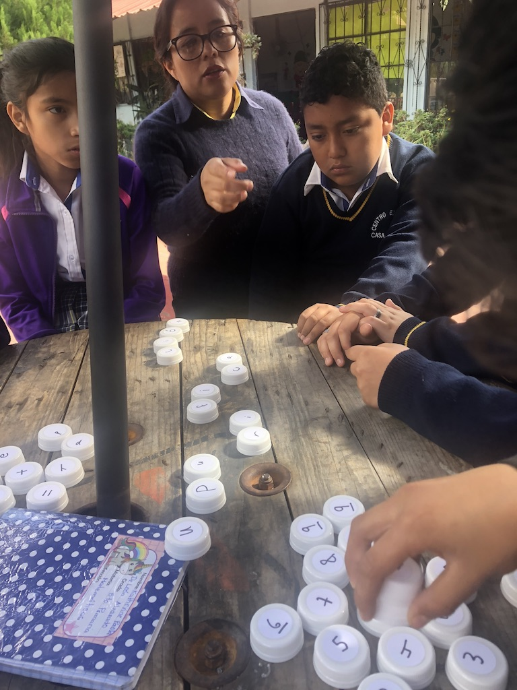
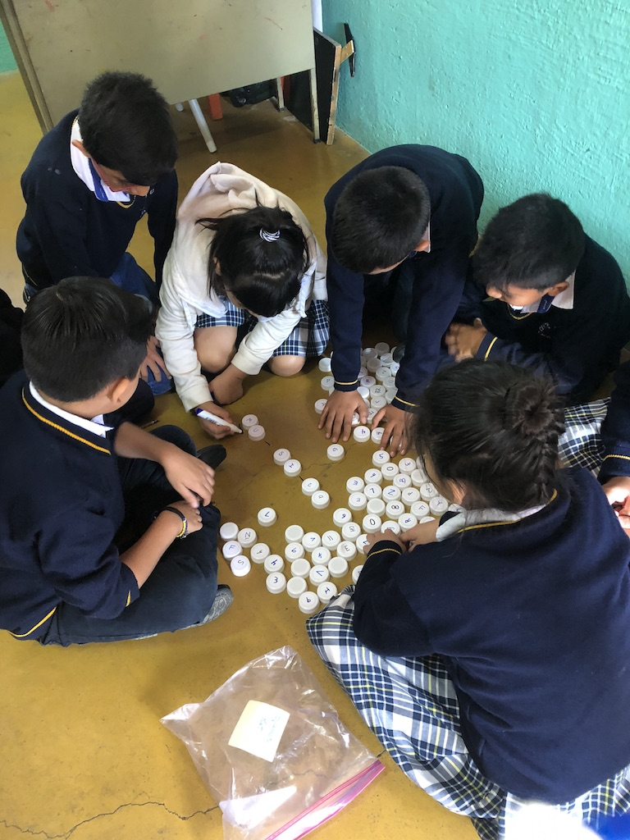
Los Amigos de Casa del Nino
Jocotenango, Guatemala

Slide 48
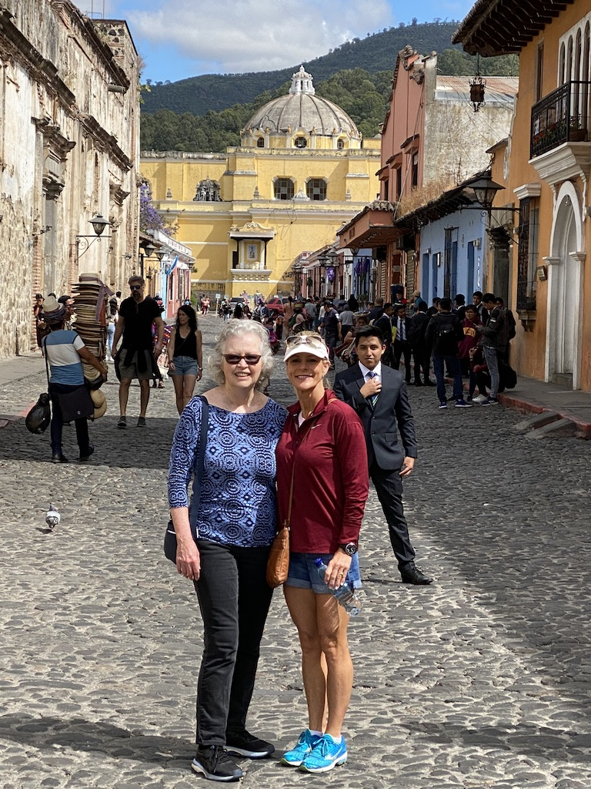
Los Amigos de Casa del Nino
Jocotenango, Guatemala
Through collaboration with Peggy Pillard, the Cap Kit Program made it’s way to Guatemala.
Peggy started this school and has given her time, energy and resources tirelessly for the students, teachers and larger community.

Slide 49
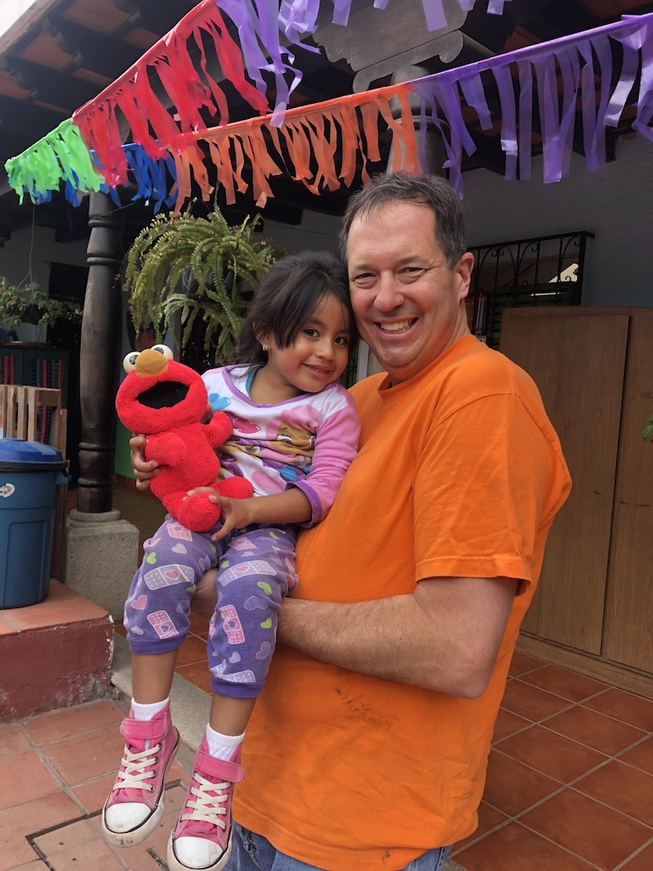
Los Amigos de Casa del Nino
Jocotenango, Guatemala
Michael Fitzpatrick did anything and everything to support the program and help bring it to Guatemala. He assisted at the school in whatever way was helpful and helped bring joy to the students.

Slide 50
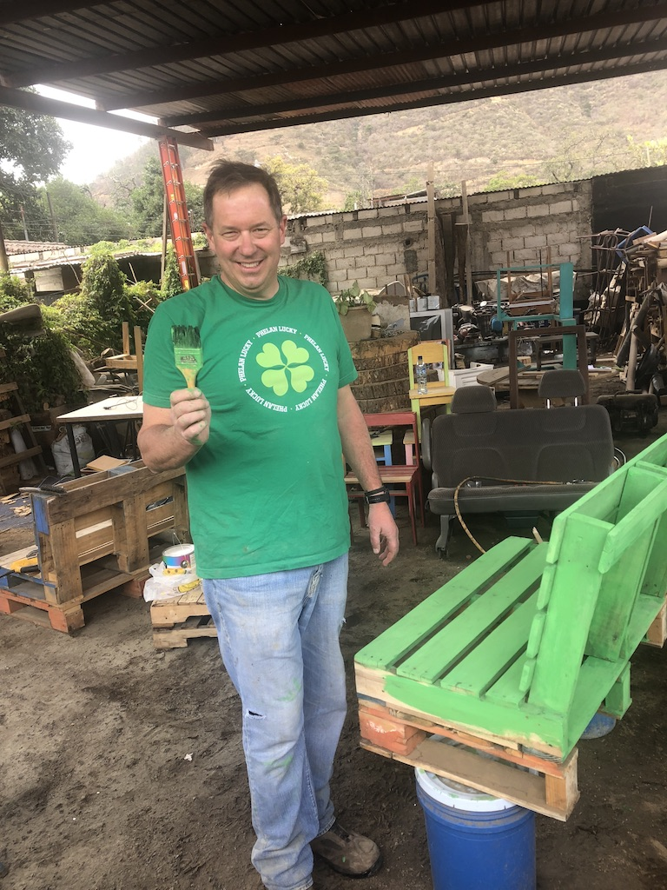

Los Amigos de Casa del Nino
Jocotenango, Guatemala

Slide 51
My Goal Today was:
To share my story & give you a hands-on experience
To enlighten you with an example, born right here at WCU, on how you can begin to positively impact the world which starts with shifting your perspective to look at the world through the lens of a Global Citizen
To (hopefully) inspire you

Slide 52
Remember
“A journey of a thousand miles begins with a single step” Lao Tzu
What it takes:
  an idea, a solid game plan, time, passion, collaborative help from others, & the courage to start & take risks

Slide 53

“Life’s persistent and most urgent question is,
“What are you doing for others?’”
Dr. Martin Luther King, Jr.
For more information about Cap Kits contact
Dr. Donna Sanderson at:
dsanderson@wcupa.edu

